Slide 1
Chapter 12
Comparing Several Independent Means

Slide 2
A Puppy Example (1)
A puppy therapy RCT in which we randomized people into three groups:
  A control group
  15 minutes of puppy therapy
  30 minutes of puppy contact.
The outcome is happiness (0 = unhappy) to 10 (happy).
Now we’re comparing three groups? Three t-tests?
Notes:
RCT = randomized control trial

Slide 3
Analysis of Variance (ANOVA) (1)
ANOVA is used to compare between three or more means
  Independent, dependent, and factorial versions
Controls for type 1 error rates more efficiently than a t-test

Slide 4
Analysis of Variance (ANOVA) (2)
Looks at variance!
  Between-group variance: Variation due to differences between group means.
  Within-group variance: Variation within each group, often attributed to random error.
Test statistic for ANOVA is F
  The F-statistic is the ratio of between-group variance to within-group variance.
  A larger F suggests a greater likelihood that at least one group mean differs significantly.

Slide 5
Theory of the F-Statistic (1 of 2)
We calculate how much variability there is between scores
  Total sum of squares (SS_{T}).
We then calculate how much of this variability can be explained by the model we fit to the data.
  How much variability is due to the predictor variable/experimental manipulation, Model Sum of Squares (SS_{M})...
… and how much cannot be explained
  How much variability is due to individual differences in performance, Residual Sum of Squares (SS_{R}).

Slide 6
Theory of the F-Statistic (2 of 2)
We compare the amount of variability explained by the model (experiment), to the error in the model (individual differences).
  This ratio is called the F-statistic.
If the model explains a lot more variability than it can’t explain, then the experimental manipulation has had a significant effect on the outcome (DV).

Slide 7
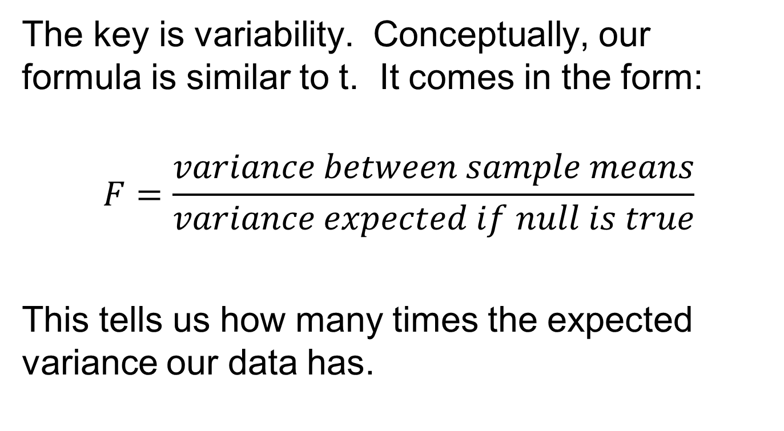
Variability
The key is variability. Conceptually, our formula is similar to t. It comes in the form:
$$F=\frac{variance between sample means}{variance expected if null is true}$$
This tells us how many times the expected variance our data has.

Slide 8
Analysis of Variance (ANOVA) (3)
ANOVA does not tell you which groups significantly differ from each other
Instead, this is an omnibus test (only tells you that a difference exists somewhere)
Follow-up or post-hoc testing is required to determine which specific comparisons are significant

Slide 9
Types of Variability (1)
We have different kinds of variability in our data. Consider these independent samples.
There is variability between samples and variability within each sample.
No Puppy | 15-Minutes | 30-Minutes
3 | 5 | 7
2 | 2 | 4
1 | 4 | 5
1 | 2 | 3
4 | 3 | 6
M = 2.20 | M = 3.2 | M = 5

Slide 10
The Data – Puppy Example (1)
No Puppy | 15-Minutes | 30-Minutes
3 | 5 | 7
2 | 2 | 4
1 | 4 | 5
1 | 2 | 3
4 | 3 | 6
M = 2.20 | M = 3.2 | M = 5
Steps:
  Calculate the group means (done already!)
  Compute the grand mean (mean of means)
  M_{G} = (M₁ + M₂ + M₃) / k = 3.467

Slide 11
We have the means, now what?
After calculating the means, we need to calculate Sums of Squares
Three types:
  SS_{T} (total)
  SS_{W} (Within group variance, sometimes called SS_{R} (Residual))
  SS_{B} (Between group variance, sometimes called SS_{M} (Model))

Slide 12
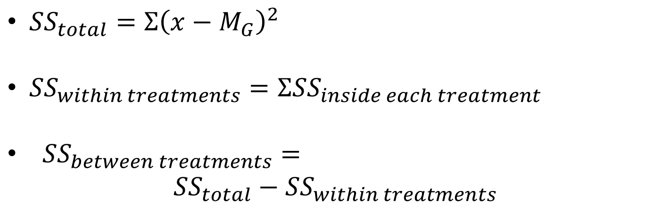
SS Formulas
${SS}_{total}=Σ{\left(x−M_{G}\right)}^{2}$
${SS}_{within treatments}=Σ{SS}_{inside each treatment}$
${SS}_{between treatments}=$
$${SS}_{total}−{SS}_{within treatments}$$

Slide 13
The Data – Puppy Example (2)
No Puppy | 15-Minutes | 30-Minutes
3 | 5 | 7
2 | 2 | 4
1 | 4 | 5
1 | 2 | 3
4 | 3 | 6
M = 2.20 | M = 3.2 | M = 5
Steps:
  Compute SS_{T}
  Compute SS_{W}
  Computer SS_{B}

Slide 14
The Data – Puppy Example (3)
No Puppy | 15-Minutes | 30-Minutes
3 | 5 | 7
2 | 2 | 4
1 | 4 | 5
1 | 2 | 3
4 | 3 | 6
M = 2.20 | M = 3.2 | M = 5
SS_{W1} = | SS_{W2} = | SS_{W3} =
Steps:
  Compute SS_{T} = 44.74
  Compute SS_{W}
  Computer SS_{B}

Slide 15
The Data – Puppy Example (4)
No Puppy | 15-Minutes | 30-Minutes
3 | 5 | 7
2 | 2 | 4
1 | 4 | 5
1 | 2 | 3
4 | 3 | 6
M = 2.20 | M = 3.2 | M = 5
SS_{W1} = 6.8 | SS_{W2} = 6.8 | SS_{W3} = 10
Steps:
  Compute SS_{T} = 44.74
  Compute SS_{W} =
  Computer SS_{B}

Slide 16
The Data – Puppy Example (5)
No Puppy | 15-Minutes | 30-Minutes
3 | 5 | 7
2 | 2 | 4
1 | 4 | 5
1 | 2 | 3
4 | 3 | 6
M = 2.20 | M = 3.2 | M = 5
SS_{W1} = 6.8 | SS_{W2} = 6.8 | SS_{W3} = 10
Steps:
  Compute SS_{T} = 44.74
  Compute SS_{W} = 23.6
  Computer SS_{B}

Slide 17
The Data – Puppy Example (6)
No Puppy | 15-Minutes | 30-Minutes
3 | 5 | 7
2 | 2 | 4
1 | 4 | 5
1 | 2 | 3
4 | 3 | 6
M = 2.20 | M = 3.2 | M = 5
SS_{W1} = 6.8 | SS_{W2} = 6.8 | SS_{W3} = 10
Steps:
  Compute SS_{T} = 44.74
  Compute SS_{W} = 23.6
  Computer SS_{B} = SS_{T} – SS_{W} =

Slide 18
The Data – Puppy Example (7)
No Puppy | 15-Minutes | 30-Minutes
3 | 5 | 7
2 | 2 | 4
1 | 4 | 5
1 | 2 | 3
4 | 3 | 6
M = 2.20 | M = 3.2 | M = 5
SS_{W1} = 6.8 | SS_{W2} = 6.8 | SS_{W3} = 10
Steps:
  Compute SS_{T} = 44.74
  Compute SS_{W} = 23.6
  Computer SS_{B} = SS_{T} – SS_{W} = 21.14

Slide 19
The Data – Puppy Example (8)
No Puppy | 15-Minutes | 30-Minutes
3 | 5 | 7
2 | 2 | 4
1 | 4 | 5
1 | 2 | 3
4 | 3 | 6
M = 2.20 | M = 3.2 | M = 5
SS_{W1} = 6.8 | SS_{W2} = 6.8 | SS_{W3} = 10
Steps:
  Compute df
  Compute MS (within and between)
  Compute F

Slide 20
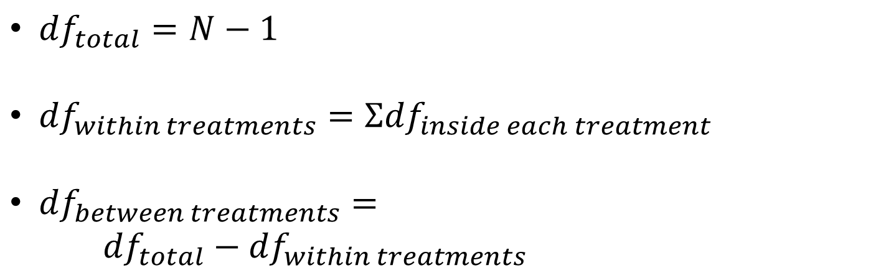
DF Formulas
${df}_{total}=N−1$
${df}_{within treatments}=Σ{df}_{inside each treatment}$
${df}_{between treatments}=$
${df}_{total}−{df}_{within treatments}$

Slide 21
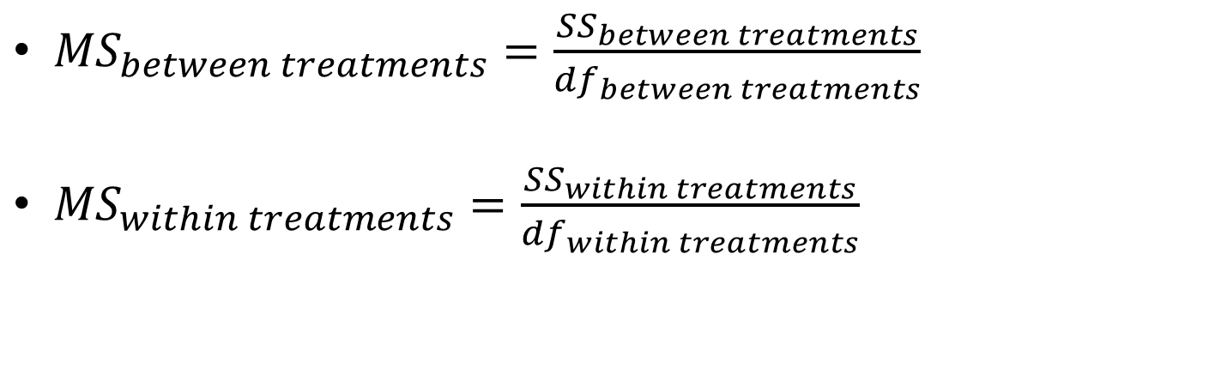
MS Formulas
${MS}_{between treatments}=\frac{{SS}_{between treatments}}{{df}_{between treatments}}$
${MS}_{within treatments}=\frac{{SS}_{within treatments}}{{df}_{within treatments}}$

Slide 22
The Data – Puppy Example (9)
No Puppy | 15-Minutes | 30-Minutes
3 | 5 | 7
2 | 2 | 4
1 | 4 | 5
1 | 2 | 3
4 | 3 | 6
M = 2.20 | M = 3.2 | M = 5
SS_{W1} = 6.8 | SS_{W2} = 6.8 | SS_{W3} = 10
df = n – 1 = 4 | df = n – 1 = 4 | df = n – 1 = 4
Steps:
  Compute df (df_{T} = 14; df_{W} = 12; df_{B} = 2)
  Compute MS (within and between)
  Compute F

Slide 23
The Data – Puppy Example (10)
No Puppy | 15-Minutes | 30-Minutes
3 | 5 | 7
2 | 2 | 4
1 | 4 | 5
1 | 2 | 3
4 | 3 | 6
M = 2.20 | M = 3.2 | M = 5
SS_{W1} = 6.8 | SS_{W2} = 6.8 | SS_{W3} = 10
df = n – 1 = 4 | df = n – 1 = 4 | df = n – 1 = 4
Steps:
  Compute df (df_{T} = 14; df_{W} = 12; df_{B} = 2)
  Compute MS: MS_{B} = 10.57; MS_{W} = 1.967
  Compute F

Slide 24
The Data – Puppy Example (11)
No Puppy | 15-Minutes | 30-Minutes
3 | 5 | 7
2 | 2 | 4
1 | 4 | 5
1 | 2 | 3
4 | 3 | 6
M = 2.20 | M = 3.2 | M = 5
SS_{W1} = 6.8 | SS_{W2} = 6.8 | SS_{W3} = 10
df = n – 1 = 4 | df = n – 1 = 4 | df = n – 1 = 4
Steps:
  Compute df (df_{T} = 14; df_{W} = 12; df_{B} = 2)
  Compute MS: MS_{B} = 10.57; MS_{W} = 1.967
  Compute F: 10.57/1.967 = 5.37

Slide 25
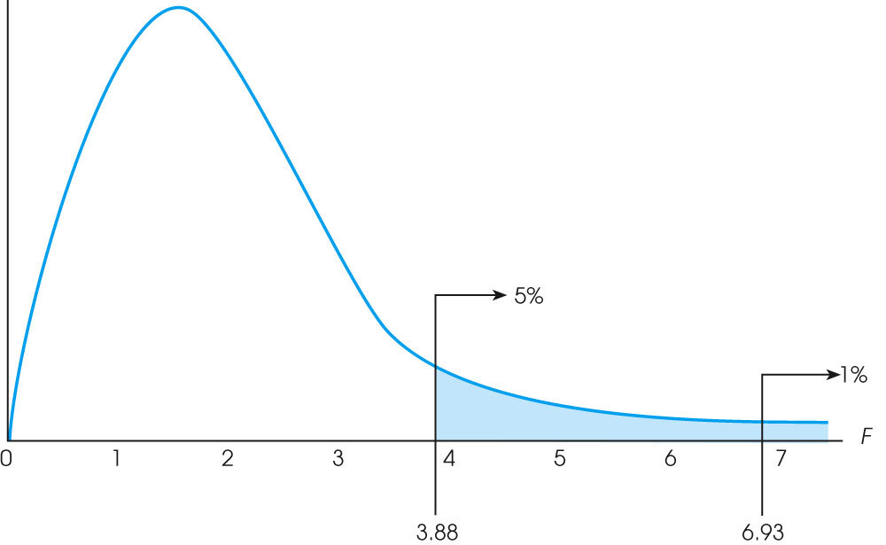
Significance and F-stat
Use the F-table to find the critical F (same idea as t-test)
Use statistical software to calculate exact p-value

Slide 26
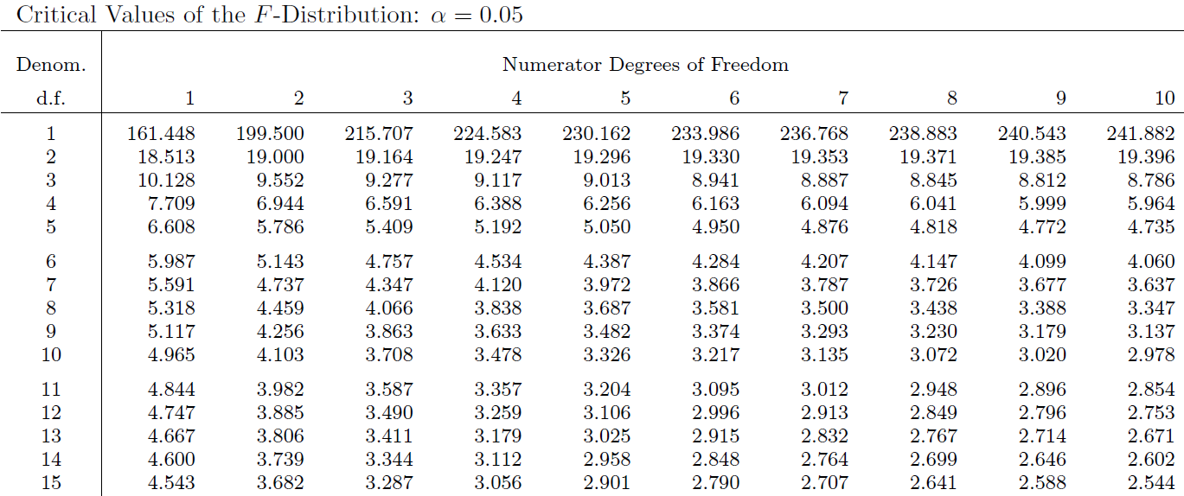
The F table

Slide 27
Reminder: Follow-up Tests
The F-statistic tells us only that the experiment was successful
  i.e. group means were different
It does not tell us specifically which group means differ from which.
We need additional tests to find out where the group differences lie.

Slide 28
How?
Orthogonal Contrasts/Comparisons
  Hypothesis driven
  Planned a priori
Post hoc Tests
  Not Planned (no hypothesis)
  Compare all pairs of means (separate t-tests)

Slide 29
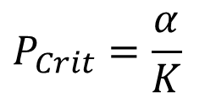
Post Hoc Tests
Compare each mean against all others.
In general terms, they use a stricter criterion to accept an effect as significant.
  Hence, control the family-wise error rate.
  Simplest example is the Bonferroni method:
$$P_{Crit}=\frac{α}{K}$$
In our example, we would run Bonferronni corrected t-tests for each comparison (3 total!)

